Slide 1
Week-3 Team Presentation
Team Name: Gladiators
Team Members: Shivani Asokuma, Akash Narang, Mit Jain, Juhi Malkani
Team Lead: Shivani Asokumar

Slide 2
Project: E-commerce Website
Description: A website where users can buy/sell products
Features
Shopping Cart/ WishList
Home page, Featured Products page, individual product page
Authentication for buyers and sellers
Filtering based on products
Payment module
User management
Seller module
Product to be sold: Footwear

Slide 3
Technologies Used
MERN Stack (MongoDB, Express, React, NodeJS)
Frontend: React
Backend: Express, NodeJS
DB Management: MongoDB

Slide 4
Milestones
Learning the technology (Especially react.js and node.js)
Designing Database (ER Models - MongoDB)
Finalize and implement design templates
Start coding backend as well as front end.
Work on following pages:
Product listing page
Home page
Individual product page
Shopping cart
Checkout

Slide 5
What’s been accomplished so far
Discussed core tech stack and key features to add in the website
Finalized core features and future scope
Finalized design template
Started implementation of template
Encountered a decision problem - use React template or build from scratch. (To be finalized end of current week).
Started understanding the tech stack (i.e React, Node, MongoDB)

Slide 6
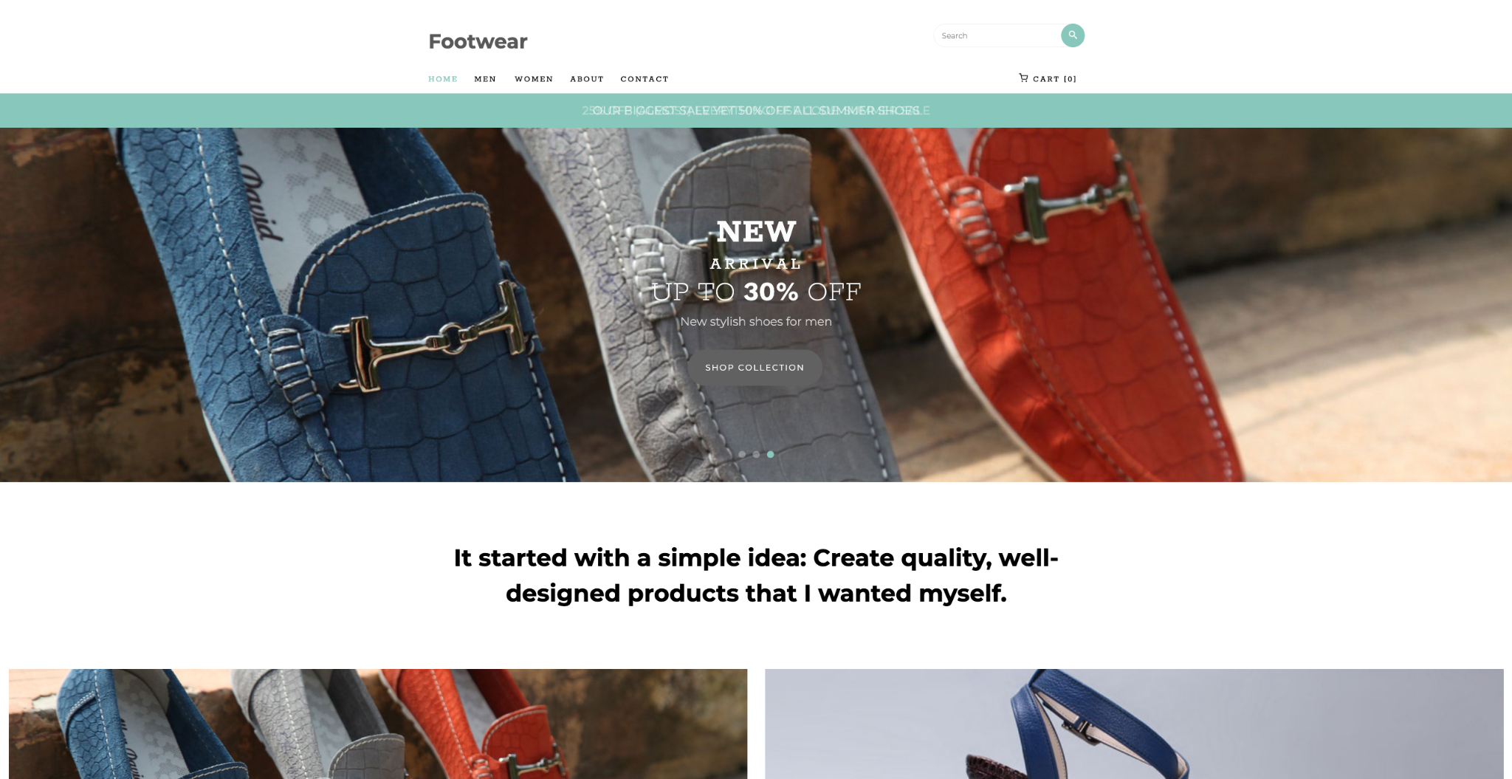
Website Design

Slide 7
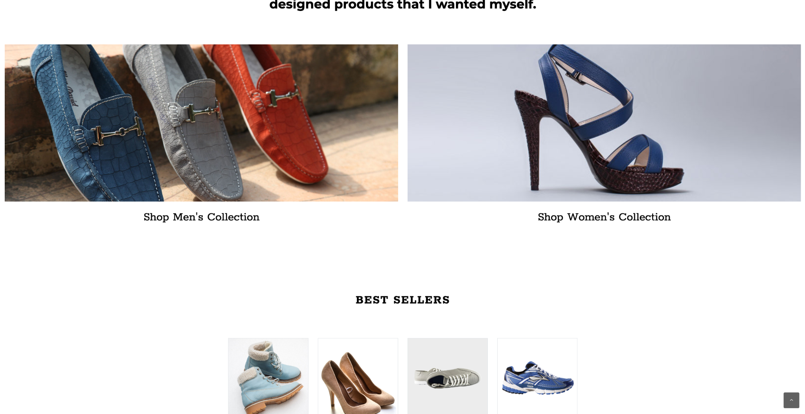
Website Design

Slide 8
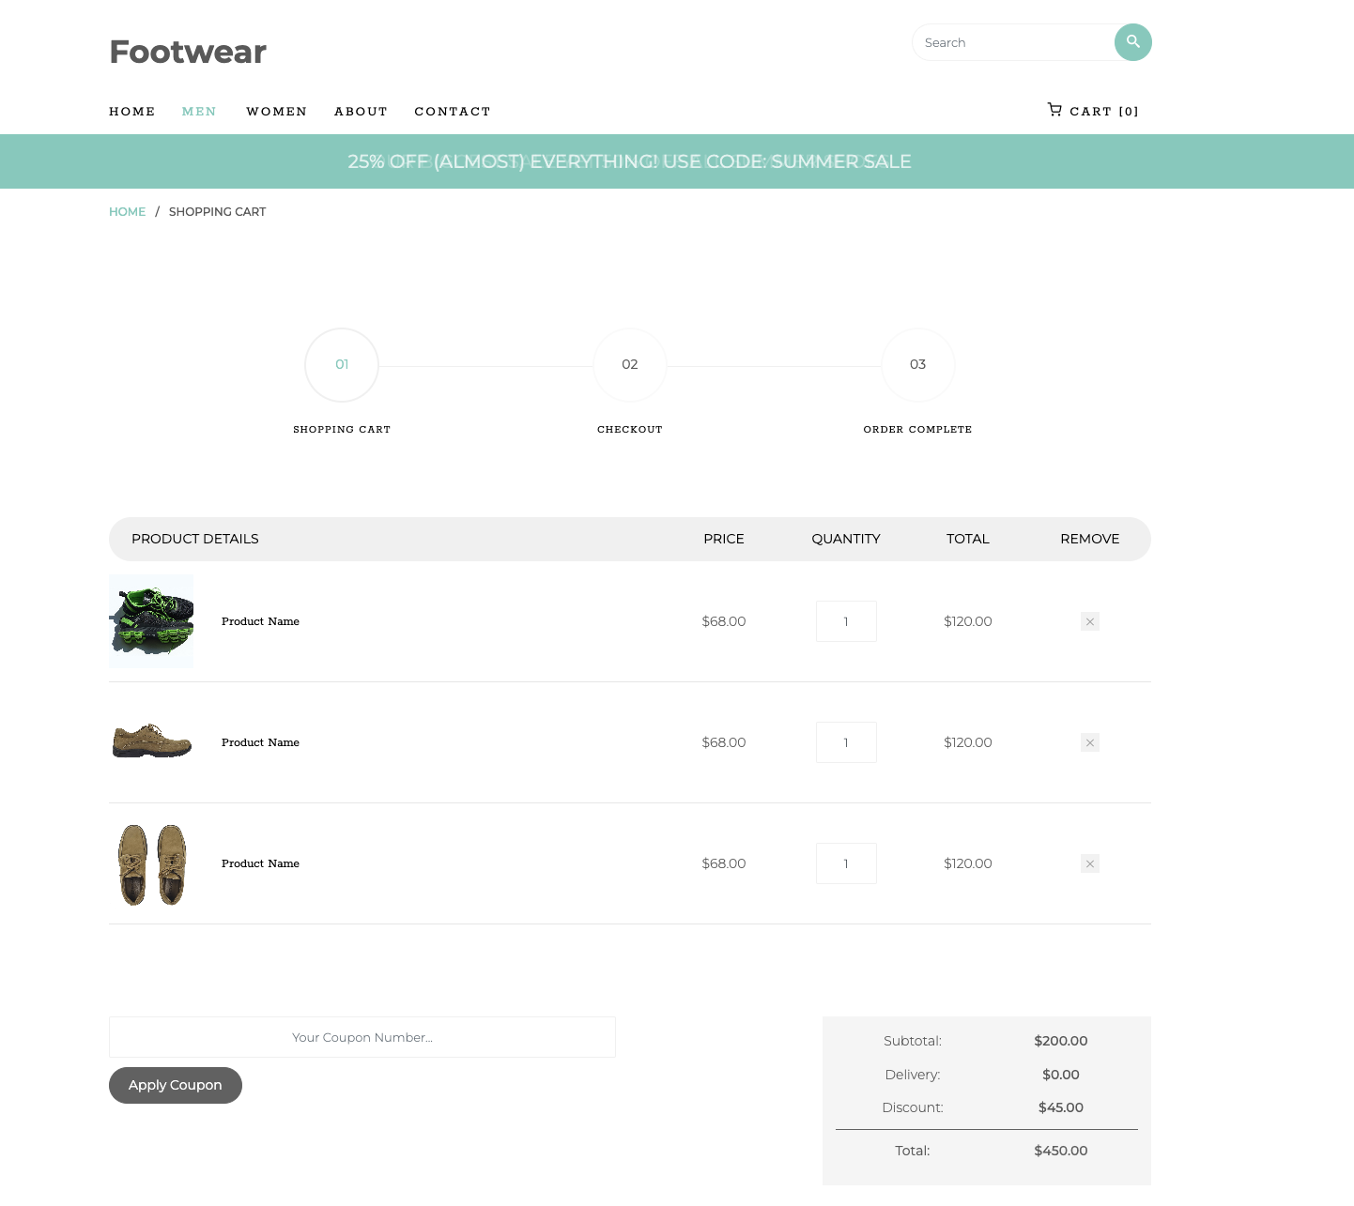
Website Design

Slide 9
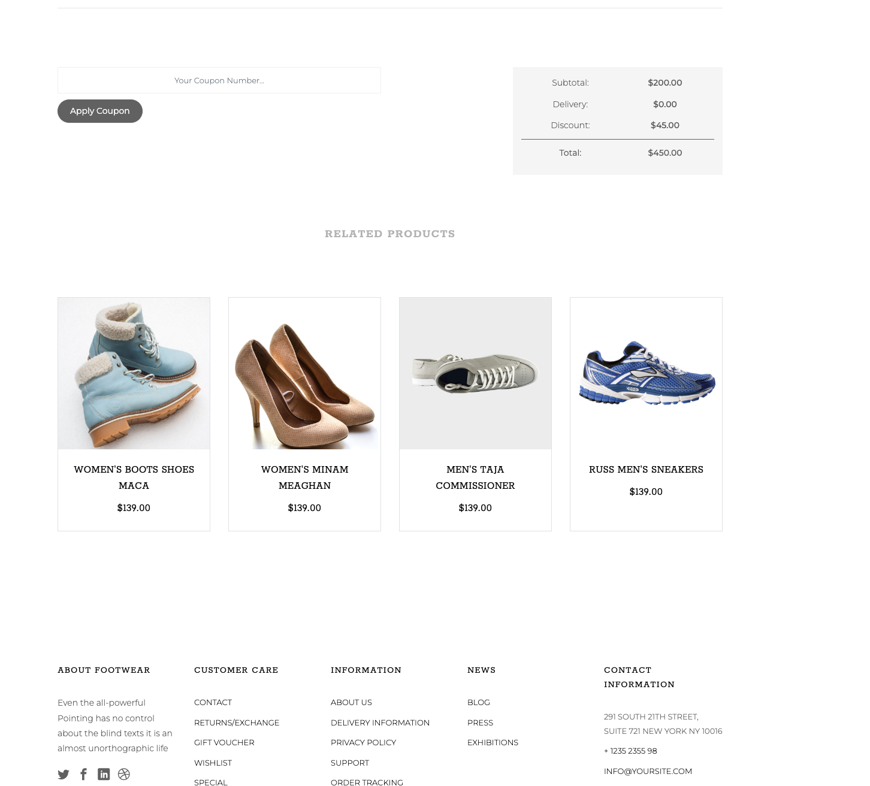
Website Design

Slide 10
Role Assignments
Shivani: Frontend
Mit: Mostly working on Backend but also helping with Frontend
Akash: Backend
Juhi: Frontend

Slide 11
Job Assignments for Week-4
Akash - Finish learning Node.js, design backend architecture and deployment platform.
Juhi - Pick up React.js, finalize and implement designs
Shivani - Finalize and implement designs
Mit - Finish learning Node.js, design backend architecture and deployment platform.

Slide 12
Feedback
Ideas that inspired Team Codescapes
Authenticated users have extra features
Technologies used in both teams
MERN stack
Suggestions for team Gladiators
Filters may be a problem if product selection isn’t large enough
Connect to Paypal / Google API

Slide 13
Thank you!

